Slide 1
Probability Distributions

Slide 2
Learning Goals
Discrete and continuous probability distributions
Sample vs distribution
Central limit theorem
Maximum Likelihood

Slide 3
Random Variables
A random variable could be the spiking rate of a particular neuron. Each time you record the spiking rate, it may be different than the previous time.
However, you might expect that most observations of the spiking rate should distribute themselves in some way around some sort of average expected value.
Probability distributions describe how likely you are to observe different values of a random variable.
e.g. What’s the probability that you’ll measure a spiking rate within 1 Hz of theta rhythm?
Discrete random variables
e.g. binary decisions: coin toss, did or did not fire an action potential
e.g. counting things: number of spikes in a minute, number of vesicles released per action potential
Continuous random variables
e.g. neuron spiking rate, vesicle release probability, spontaneous postsynaptic current peak amplitude

Slide 4
Random Numbers
numpy.random.rand() # random number in [0.0, 1.0)
Random numbers are random enough for our purposes, but they do follow a deterministic sequence if started from the same point.
numpy.random.seed(82) # start random number generation with known seed
numpy.random.rand() # repeatable sequence of random numbers

Slide 5
Bernoulli Distribution
Binary random variable
e.g. coin toss (Heads or Tails?)
Probability p = 0.7
Probability 1 – p = 0.3
numpy.random.rand() > p
scipy.stats.bernoulli.rvs()

Slide 6
Binomial Distribution
Multiple identical and independent binary random variables
e.g. multiple coin tosses (2 out of 3 Heads?)
1st toss
2nd toss
3rd toss

Slide 7
Binomial Distribution
Multiple identical and independent binary random variables
e.g. multiple coin tosses (2 out of 3 Heads?)
Fair coin
1st toss
2nd toss
3rd toss
p(0 Heads) = 1 * 0.5³ = 0.125
p(1 Heads) = 3 * 0.5³ = 0.375
p(2 Heads) = 3 * 0.5³ = 0.375
p(3 Heads) = 1 * 0.5³ = 0.125
0.5³
0.5²
0.5³
0.5
0.5³
0.5²
0.5³
0.5³
0.5²
0.5³
0.5
0.5³
0.5²
0.5³

Slide 8
Binomial Distribution
Multiple identical and independent binary random variables
e.g. multiple coin tosses (2 out of 3 Heads?)
Fair coin
Biased coin (40% Heads)
1st toss
2nd toss
3rd toss
p(0 Heads) = 1 * 0.5³ = 0.125
p(1 Heads) = 3 * 0.5³ = 0.375
p(2 Heads) = 3 * 0.5³ = 0.375
p(3 Heads) = 1 * 0.5³ = 0.125
p(0 Heads) = 1 * 0. 6³ = 0.216
p(1 Heads) = 3 * 0.4 * 0.6² = 0.432
p(2 Heads) = 3 * 0.4² * 0.6 = 0.288
p(3 Heads) = 1 * 0.4³ = 0.064
0.5³
0.4³
0.5²
0.4²
0.5³
0.4² * 0.6
0.5
0.4
0.5³
0.4² * 0.6
0.5²
0.4*0.6
0.5³
0.4 * 0.6²
0.5³
0.4² * 0.6
0.5²
0.6*0.4
0.5³
0.4 * 0.6²
0.5
0.6
0.5³
0.4 * 0.6²
0.5²
0.6²
0.5³
0.6³

Slide 9
Binomial Distribution
# of ways to get 2 heads out of 3 tosses
(p_{Heads})² * (p_{Tails})¹
= (p_{Heads})² * (1 - p_{Heads})¹
Multiple identical and independent binary random variables
e.g. multiple coin tosses (2 out of 3 Heads?)
Fair coin
Biased coin (40% Heads)
1st toss
2nd toss
3rd toss
p(0 Heads) = 1 * 0.5³ = 0.125
p(1 Heads) = 3 * 0.5³ = 0.375
p(2 Heads) = 3 * 0.5³ = 0.375
p(3 Heads) = 1 * 0.5³ = 0.125
p(0 Heads) = 1 * 0. 6³ = 0.216
p(1 Heads) = 3 * 0.4 * 0.6² = 0.432
p(2 Heads) = 3 * 0.4² * 0.6 = 0.288
p(3 Heads) = 1 * 0.4³ = 0.064
0.5³
0.4³
0.5²
0.4²
0.5³
0.4² * 0.6
0.5
0.4
0.5³
0.4² * 0.6
0.5²
0.4*0.6
0.5³
0.4 * 0.6²
0.5³
0.4² * 0.6
0.5²
0.6*0.4
0.5³
0.4 * 0.6²
0.5
0.6
0.5³
0.4 * 0.6²
0.5²
0.6²
0.5³
0.6³

Slide 10
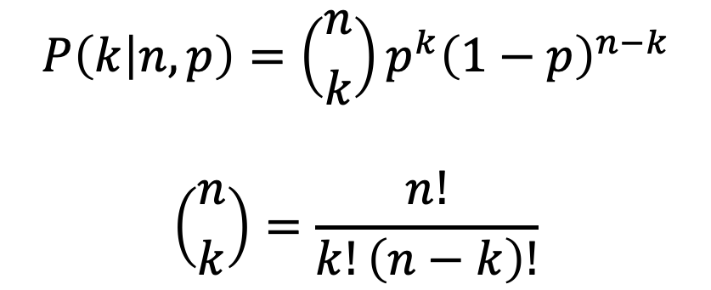


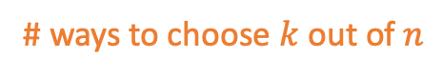
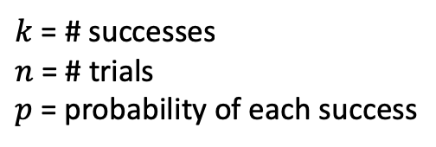
Binomial Distribution
# of ways to get 2 heads out of 3 tosses
(p_{Heads})² * (p_{Tails})¹
= (p_{Heads})² * (1 - p_{Heads})¹
Multiple identical and independent binary random variables
e.g. multiple coin tosses (2 out of 3 Heads?)
Biased coin (40% Heads)
probability of $n−k$ failures
p(0 Heads) = 1 * 0. 6³ = 0.216
p(1 Heads) = 3 * 0.4 * 0.6² = 0.432
p(2 Heads) = 3 * 0.4² * 0.6 = 0.288
p(3 Heads) = 1 * 0.4³ = 0.064
probability of $k$ successes
# ways to choose $k$ out of $n$
0.4³
$$P\left(k | n,p\right)=\left({n \atop k}\right)p^{k}{\left(1−p\right)}^{n−k}$$
$$\left({n \atop k}\right)=\frac{n!}{k!\left(n−k\right)!}$$
0.4²
0.4² * 0.6
0.4
0.4² * 0.6
0.4*0.6
0.4 * 0.6²
0.4² * 0.6
0.6*0.4
0.4 * 0.6²
0.6
$k$ = # successes
$n$ = # trials
$p$= probability of each success
0.4 * 0.6²
0.6²
0.6³

Slide 11
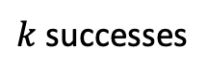
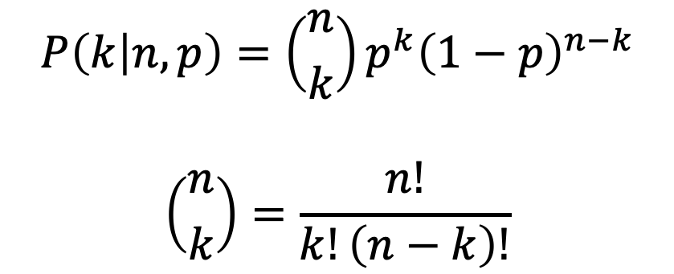
Binomial Distribution
Multiple identical and independent binary random variables
e.g. multiple coin tosses (2 out of 3 Heads?)
probability of $n−k$ failures
probability of $k$ successes
# ways to choose $k$ out of $n$
$$P\left(k | n,p\right)=\left({n \atop k}\right)p^{k}{\left(1−p\right)}^{n−k}$$
$$\left({n \atop k}\right)=\frac{n!}{k!\left(n−k\right)!}$$
$k$ successes
$k$ = # successes
$n$ = # trials
$p$= probability of each success
numpy.random.binomial(n,p)
scipy.stats.binom(k, n, p)

Slide 12
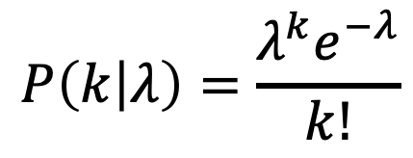
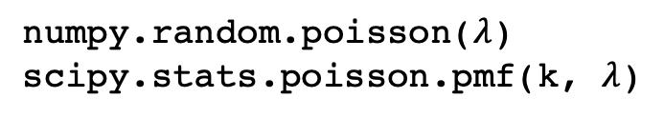
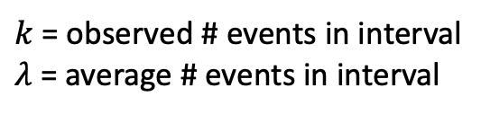
Poisson Distribution
Number of independent random events occurring at some overall rate in an interval (e.g. time or space)
e.g. # of spikes in a minute, # vesicles released at a synapse
$$P\left(k | λ\right)=\frac{λ^{k}e^{−λ}}{k!}$$
$k$ = observed # events in interval
$λ$ = average # events in interval
numpy.random.poisson($λ$)
scipy.stats.poisson.pmf(k, $λ$)

Slide 13
Continuous Probability Density Functions (PDFs)

Slide 14
Cumulative Distribution Function (CDF)
area

Slide 15
Survival Function (SF) = 1 - CDF
SF(x=1)
area
CDF(x=1)

Slide 16
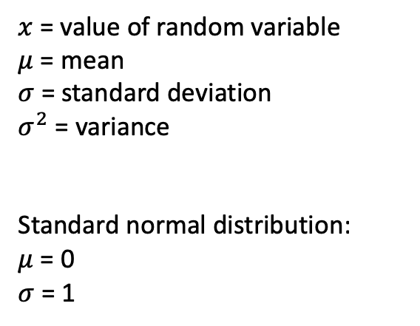
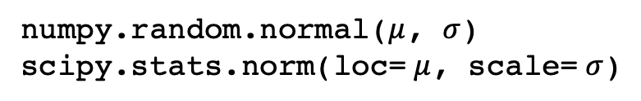
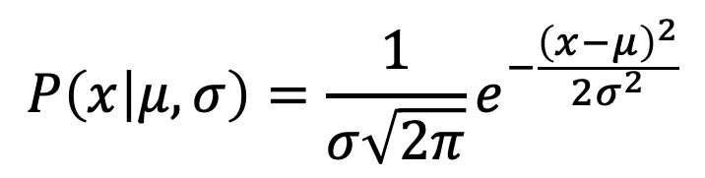
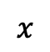
Gaussian/Normal Distribution
e.g. random fluctuations about some mean
$$P\left(x | μ,σ\right)=\frac{1}{σ\sqrt{2π}}e^{−\frac{{\left(x−μ\right)}^{2}}{2σ^{2}}}$$
Probability
$x$ = value of random variable
$μ$ = mean
$σ$ = standard deviation
$σ^{2}$ = variance
Standard normal distribution:
$μ$ = 0
$σ$ = 1
$$x$$
numpy.random.normal($μ$, $σ$)
scipy.stats.norm(loc= $μ$, scale= $σ$)

Slide 17
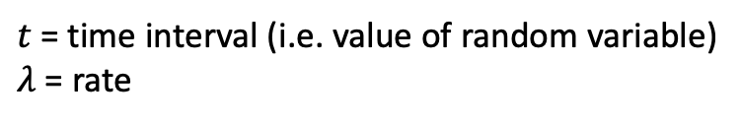
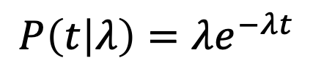
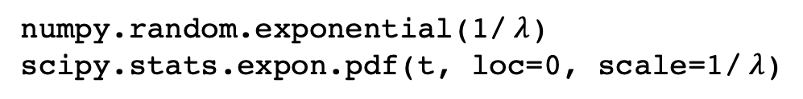
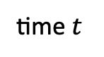
Exponential Distribution
e.g. time intervals between events such as time between spikes, time a protein spends in a given conformation
$$P\left(t | λ\right)=λe^{−λt}$$
Probability
$t$ = time interval (i.e. value of random variable)
$λ$ = rate
time $t$
numpy.random.exponential(1/ $λ$)
scipy.stats.expon.pdf(t, loc=0, scale=1/ $λ$)

Slide 18
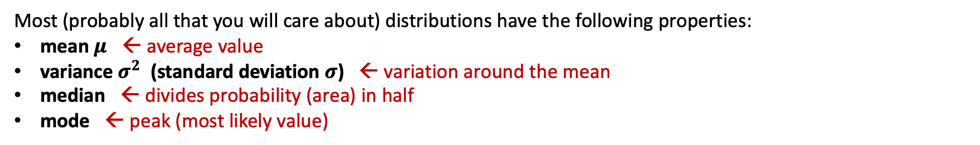
Distribution Properties
Most (probably all that you will care about) distributions have the following properties:
mean $μ$ ← average value
variance $σ^{2}$ (standard deviation $σ$) ← variation around the mean
median ← divides probability (area) in half
mode ← peak (most likely value)
scipy.stats.lognorm
Lognormal distribution

Slide 19
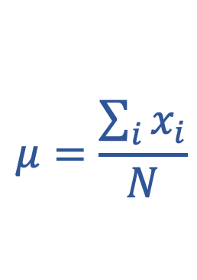

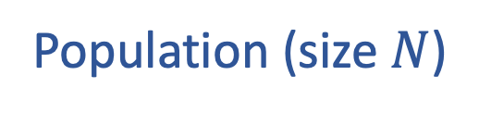

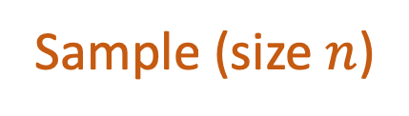
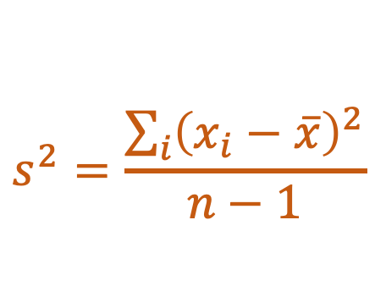
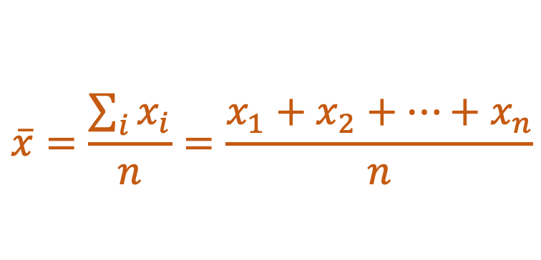
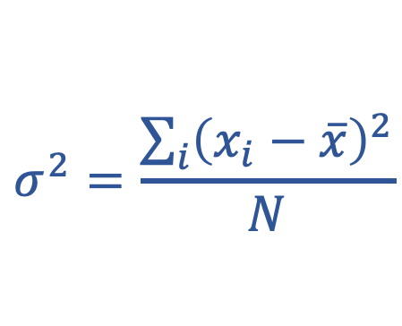
Sample vs. Population Distribution
Population
size $N$
Typically, we don’t know the population distribution.
We try to infer it based on our sample distribution.
Sample
size $n$
Population (size $N$)
Sample (size $n$)
$$μ=\frac{\sum_{i}{x_{i}}}{N}$$
$$\overline{x}=\frac{\sum_{i}{x_{i}}}{n}=\frac{x_{1}+x_{2}+…+x_{n}}{n}$$
Mean
$$σ^{2}=\frac{\sum_{i}{{\left(x_{i}−\overline{x}\right)}^{2}}}{N}$$
$$s^{2}=\frac{\sum_{i}{{\left(x_{i}−\overline{x}\right)}^{2}}}{n−1}$$
Variance
https://www.khanacademy.org/math/ap-statistics/summarizing-quantitative-data-ap/more-standard-deviation/v/review-and-intuition-why-we-divide-by-n-1-for-the-unbiased-sample-variance

Slide 20
Sample vs. Population Distribution
Population
size $N$
Likely to be different!!!
Sample
size $n$
Population (size $N$)
Sample (size $n$)
$$μ=\frac{\sum_{i}{x_{i}}}{N}$$
$$\overline{x}=\frac{\sum_{i}{x_{i}}}{n}=\frac{x_{1}+x_{2}+…+x_{n}}{n}$$
Mean
$$σ^{2}=\frac{\sum_{i}{{\left(x_{i}−\overline{x}\right)}^{2}}}{N}$$
$$s^{2}=\frac{\sum_{i}{{\left(x_{i}−\overline{x}\right)}^{2}}}{n−1}$$
Variance
https://www.khanacademy.org/math/ap-statistics/summarizing-quantitative-data-ap/more-standard-deviation/v/review-and-intuition-why-we-divide-by-n-1-for-the-unbiased-sample-variance

Slide 21
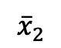
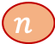
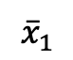
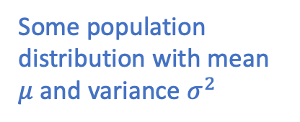
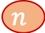

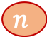
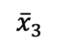
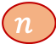
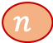
Central Limit Theorem
$$n$$
$${\overline{x}}_{1}$$
$$n$$
$$n$$
$$n$$
$${\overline{x}}_{2}$$
$$N$$
$$n$$
$$n$$
$${\overline{x}}_{3}$$
.
.
.
Some population distribution with mean $μ$ and variance $σ^{2}$

Slide 22
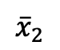
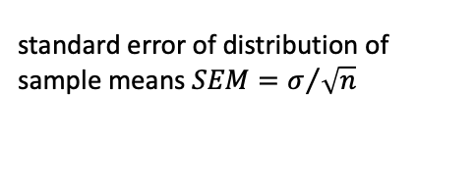
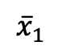
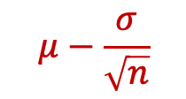
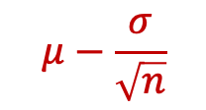

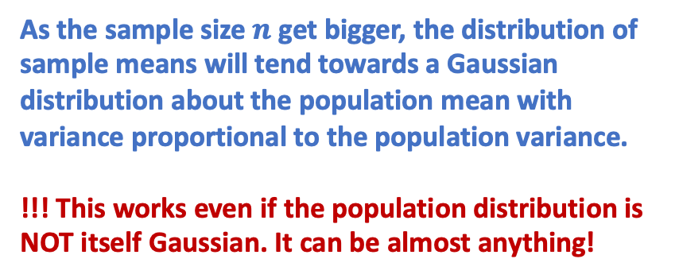
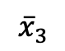
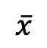
As the sample size $n$ get bigger, the distribution of sample means will tend towards a Gaussian distribution about the population mean with variance proportional to the population variance.
!!! This works even if the population distribution is NOT itself Gaussian. It can be almost anything!
Central Limit Theorem
$$n$$
$${\overline{x}}_{1}$$
$$n$$
$$n$$
$$n$$
$${\overline{x}}_{2}$$
$$N$$
$$n$$
$$n$$
$${\overline{x}}_{3}$$
.
.
.
standard error of distribution of sample means $SEM=σ/{\sqrt{n}}$
Some population distribution with mean $μ$ and variance $σ^{2}$
$${\overline{x}}_{1}$$
$${\overline{x}}_{2}$$
$${\overline{x}}_{3}$$
$$\overline{x}$$
$$μ−\frac{σ}{\sqrt{n}}$$
$$μ$$
$$μ−\frac{σ}{\sqrt{n}}$$
https://www.youtube.com/watch?v=YAlJCEDH2uY

Slide 23
Central Limit Theorem
Normal-ish distributions are everywhere. Consider a complicated biological processes where the parameter that you measure results from the average of multiple underlying processes. By the central limit theorem we might expect our measurements to have a normal distribution even if the underlying processes do not.
$$n$$
$${\overline{x}}_{1}$$
$$n$$
$$n$$
$$n$$
$${\overline{x}}_{2}$$
$$N$$
$$n$$
$$n$$
$${\overline{x}}_{3}$$
.
.
.
standard error of distribution of sample means $SEM=σ/{\sqrt{n}}$
Some population distribution with mean $μ$ and variance $σ^{2}$
$${\overline{x}}_{1}$$
$${\overline{x}}_{2}$$
$${\overline{x}}_{3}$$
$$\overline{x}$$
$$μ−\frac{σ}{\sqrt{n}}$$
$$μ$$
$$μ−\frac{σ}{\sqrt{n}}$$

Slide 24
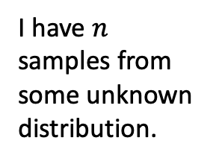
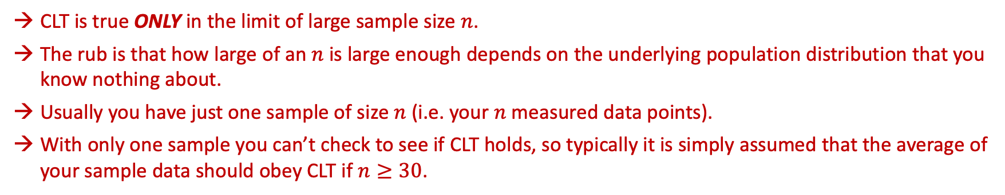
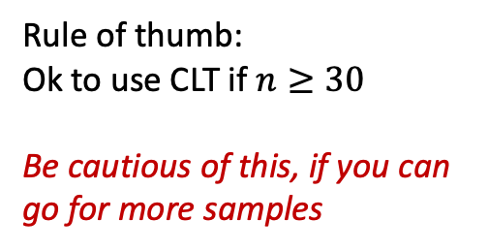
Central Limit Theorem (CLT): A word of caution
CLT is true ONLY in the limit of large sample size $n$.
The rub is that how large of an $n$ is large enough depends on the underlying population distribution that you know nothing about.
Usually you have just one sample of size $n$ (i.e. your $n$ measured data points).
With only one sample you can’t check to see if CLT holds, so typically it is simply assumed that the average of your sample data should obey CLT if $n≥30$.
I have $n$ samples from some unknown distribution.
Do I have enough samples to use CLT?
But I need to know the distribution that the samples came from to know if I have enough samples.
Rule of thumb:
Ok to use CLT if $n≥30$
Be cautious of this, if you can go for more samples

Slide 25
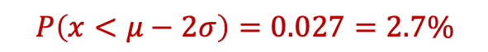
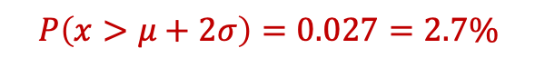
Confidence Interval
scipy.stats.norm.ppf(0.027)
scipy.stats.norm.ppf(0.973)
$$x$$
$$P\left(x<μ−2σ\right)=0.027=2.7\%$$
$$P\left(x>μ+2σ\right)=0.027=2.7\%$$

Slide 26
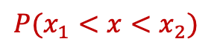
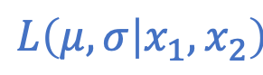
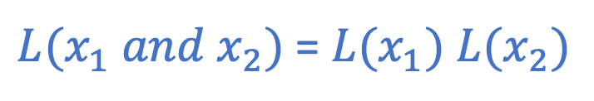
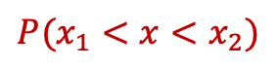
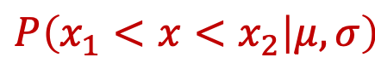








Likelihood
$${P(x}_{1}<x<x_{2})$$
$${P(x}_{1}<x<x_{2})$$
$${P(x}_{1}<x<x_{2})$$
$${L(x}_{1})$$
$${L(x}_{1})$$
$${L(x}_{1} or x_{2})$$
$${L(x}_{2})$$
$${L(x}_{2})$$
$$L\left(μ, σ | x_{1}, x_{2}\right)$$
$$P\left(x_{1}<x<x_{2} | μ, σ\right)$$
$$L\left(model | data\right)$$
$$P\left(data | model\right)$$
${L(x}_{1} and x_{2})$ = ${L(x}_{1})$ ${L(x}_{2})$
${{LL(x}_{1} and x_{2})\text{ =} ln⁡(L(x}_{1} and x_{2})$) = ${ln⁡(L(x}_{1}))$+ $ln({L(x}_{2}))$ = ${LL(x}_{1})$ +${LL(x}_{2})$

Slide 27
Maximum Likelihood Estimation (MLE)
Goal: find distribution parameters that maximize the likelihood of all the data.
→ Fitting a histogram of your data is NOT as good as fitting the data themselves !!!
PDF
counts

